Slide 1
First oral cholera vaccination campaign in Iraq during an outbreak and humanitarian crisis: Findings from a post-campaign coverage survey, 2015
Steven Russell, MSPH
Eugene Lam, MD
Wasan Al Tamimi, MPH
Muhammad Obaid-ul Islam Butt, MD
Curtis Blanton, MS
Altaf Sadrudin Musani, MD
Kashmira Date, MD
Center for Global Health
Emergency Response and Recovery Branch
Notes:
Hello, my name is Steven Russell and I am here to talk about an Oral Cholera Vaccination campaign and coverage survey that was conducted by CDC and WHO in Iraq last year. The results of the survey are in the process of being published in the journal emerging infectious diseases. In the next 12 minutes I will share with you a brief summary of our findings.

Slide 2
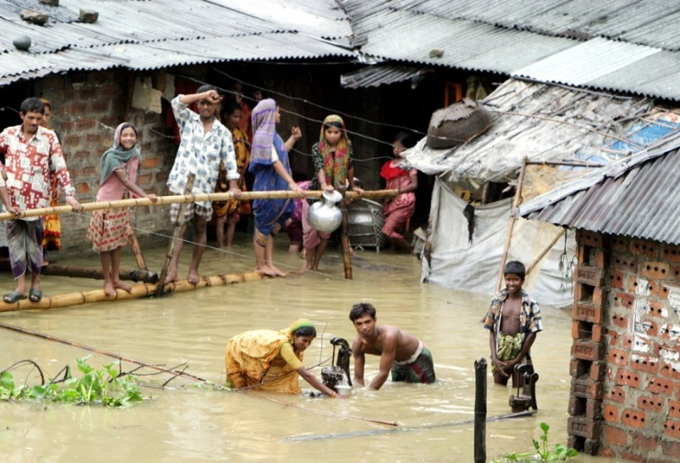
Background about Cholera
Cholera is an acute enteric infection caused by the bacterium Vibrio cholera
Transmitted through the oral-fecal route by ingesting contaminated food or water.
Cholera is a disease characterized by
Severe watery diarrhea
Rapid and severe dehydration
Death without adequate treatment
Expected Global burden
1.4 billion at risk
3 to 5 million cases
120 thousand deaths
Notes:
A little bit of background about Cholera:
Cholera is an acute enteric infection caused by the bacterium Vibrio cholera
Transmitted through the oral-fecal route by ingesting contaminated food or water.
The disease is characterized by severe watery diarrhea, rapid dehydration, and in serious cases, death.
The global burden is immense. There are 1.4 billion people at risk and an estimated 3 to 5 million cases and 120,000 deaths per year.

Slide 3
Cholera Control Measures
Water, sanitation and hygiene (WASH) interventions are the primary method of preventing the spread of cholera
Global stockpile of 2 million doses of oral cholera vaccine (OCV) was established in 2013
Intended to provide rapid deployment of oral cholera vaccine in emergency and outbreak situations
WHO recently approved a third manufacturer of OCV to increase global supply to 6 million doses for 2016
Notes:
The primary method of preventing the spread of cholera is through WASH interventions aimed at providing access to safe water and improving sanitation conditions.
As a complementary method of controlling the disease, a global stockpile of oral cholera vaccine was established in 2013. This stockpile was intended to provide rapid deployment of oral cholera vaccine in emergency and outbreak situations. Ideally, the vaccine should be used in areas that are not yet affected by cholera or where cases are just starting to be reported.
Since the establishment of the stockpile, there have been ongoing efforts to increase the number of stockpiled vaccines. In fact, WHO recently approved a 3rd manufacturer of OCV to increase global supply to 6 million doses for 2016.

Slide 4
History of Cholera in Iraq
Cholera is endemic in Iraq, mostly in the Northern region.
The country experienced a major cholera epidemic in 2007
4,690 confirmed cases including 24 deaths.
Additional outbreaks have been reported in 2008, 2012 and 2015
Notes:
Looking at specific burden of cholera in Iraq, we know that the disease is endemic in the country, particularly in the northern region.
Iraq has a history of major cholera epidemics. In 2007, an outbreak caused 4,690 confirmed cases of cholera including 24 deaths. Since then, there have been additional outbreaks in 2008, 2012, and as we will talk about, in 2015.
(Over 30,000 acute watery diarrhea cases)

Slide 5
Conflict and Displacement in Iraq
Up to 3.2 million internally displaced persons (IDPs) throughout the country in 2015
Iraq is also hosting thousands of Syrian refugees due to protracted fighting in Syria
The risk of communicable disease epidemics is heightened due to the large number of displaced populations
Notes:
In 2015, Iraq was at high risk of a cholera outbreak. There were up to 3.2 million internally displaced people living in camps due to the ongoing conflict in the country. Additionally, the country was hosting thousands of Syrian refugees due to protracted fighting in Syria.
Due to the instability in the region, the risk of communicable disease epidemics was heightened. Displaced populations often reside in camps, informal settlements or collectives centers where there may be limited access to safe drinking water, food, and sanitation facilities.

Slide 6
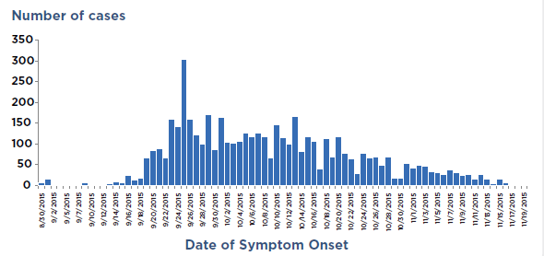
Epidemic Curve of Lab-Confirmed Cholera Cases (Aug 30 – Nov 19)
Provincial Confirmed – 4,864 cases
Initial Cholera Case
Outbreak declared by MOH
1st round of Vaccination Campaign
Notes:
Here is an epi curve showing the progression of the epidemic before oral cholera vaccine was deployed.
In late august of 2015, an initial case of cholera was confirmed in Iraq. By September 15th, the outbreak had been declared by the Iraqi MOH. From there, the outbreak continued to rapidly spread throughout the country and by October 2015 there were cases in 15 of the 18 governorates. On October 30th the 1st round of the vaccination campaign began. By mid November, there had been almost 5000 confirmed cases nation-wide.
International Coordinating Group

Slide 7
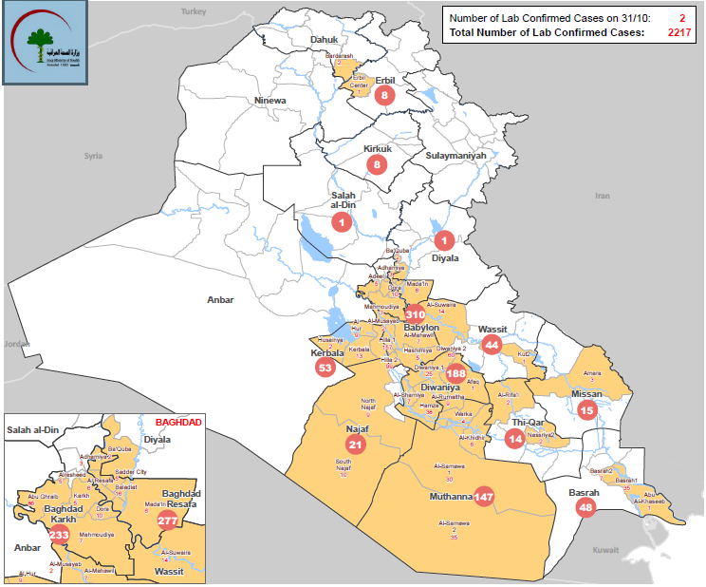
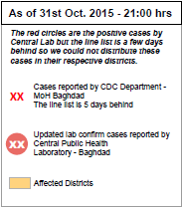
Map of Lab Confirmed Cases
Notes:
Here you can see a map showing the distribution of cases throughout the country. As you can see, the majority of the cases were in the central and southern region. There were also cases that were starting to appear in the northern region.

Slide 8
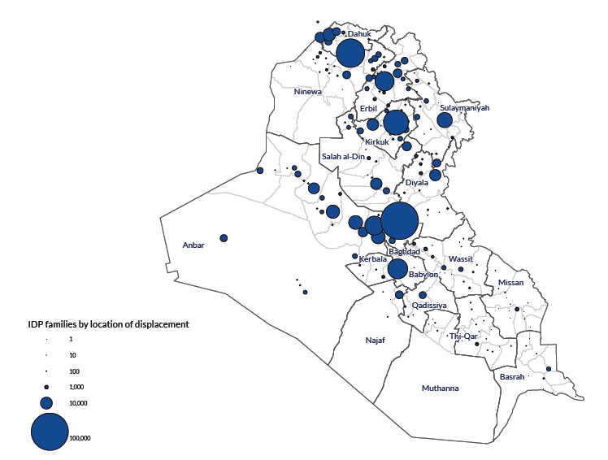
Location of IDP Families
Notes:
Here you can also see the distribution of the IDP families. Central and Northern Iraq host about 95% of the IDPs in the country.

Slide 9
Decision to Use Oral Cholera Vaccine (OCV) in Iraq
OCV Stockpile was implemented in Iraq due to:
The endemnicity of cholera, especially in the northern region
The high number of refugees and internally displaced people living in camps
Iraq’s close proximity to the Syrian border
Notes:
The OCV stockpile was implemented in Iraq for a few reasons. The first reason is that cholera is endemic in the country, so people are already at some baseline risk. Second, there are a high number of refugees and internally displaced people living in overcrowded camps with poor water sources and inadequate sanitation where the disease could potentially thrive. Third, Iraq borders Syria to the North, so one of the primary goals of the campaign was to stop cholera cases from spreading in Syria where an epidemic would be disastrous and where we would have limited ability to combat the disease.

Slide 10
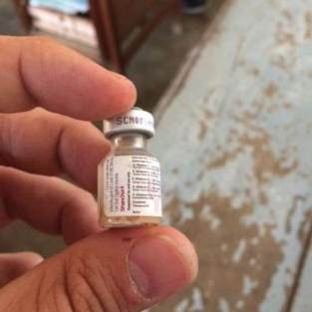
Oral Cholera Vaccine (ShancholTM)
Orally administered in 2 doses (2 to 6 weeks apart)
Recommended for ALL individuals ≥1 year
WHO pre-qualification for Shanchol in 2011
Efficacy
≈ 85% at 6 months
≈ 65% at 5 years
Good heat stability
Killed vaccine, good safety profile
Notes:
The oral cholera vaccine that we used for the campaign is called Shanchol.
According to the vaccine manufacturer, it should be administered in 2 doses and is recommended for all individuals over 1 year of age. It was WHO pre-qualified which means it meets WHO standards of quality, safety and efficacy.
The particular vaccine we chose for this campaign in called Shanchol (Euvichol , Dukoral)
Stable for 21 days at 37° C
International Coordinating Group manages stockpile
South Sudan study - The unadjusted single-dose vaccine effectiveness was 80·2%

Slide 11
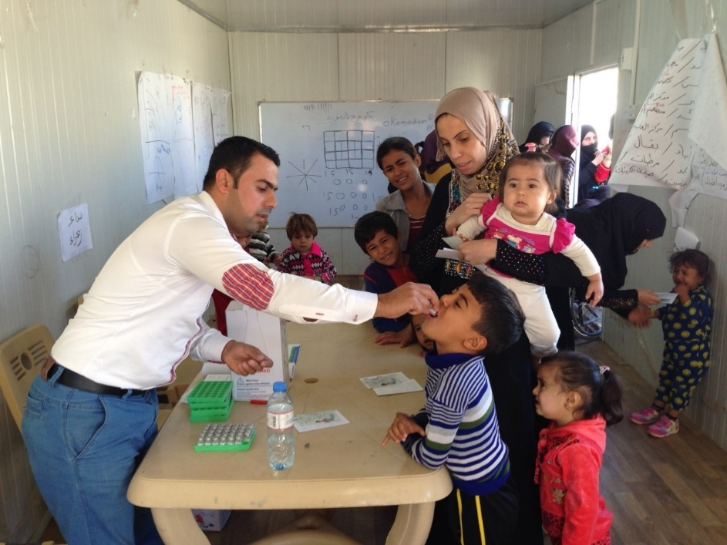
Oral Cholera Vaccination (OCV) Campaign
The campaign targeted approximately 255,000 persons aged ≥1 year living in selected refugee camps, IDP camps, and collective centers
Deployment of ~510,000 OCV doses
Largest deployment of OCV to date from the Global OCV Stockpile established for outbreak and humanitarian response
Notes:
The campaign targeted 255,000 people living in selected refugee camps, IDP camps, and collective centers throughout the country. Collective centers are informal settlements where displaced people gather.
It was the largest deployment of oral cholera vaccine from the global OCV stockpile, with over 510,000 doses distributed.
-----
Due to the large number of IDPs in country and the limited supply of OCV, only IDP camps at full capacity or overcrowded were selected.

Slide 12
Post-Campaign Vaccination Coverage Survey
OCV has never been used in Iraq before
Based on decisions of the MOH, a vaccination coverage survey was conducted immediately after the 2nd round of OCV campaign
Conducted by WHO, CDC, and the Iraqi Red Crescent Society
To evaluate:
vaccine uptake
barriers to vaccination
adverse events
Notes:
Oral Cholera Vaccine had never been used in Iraq before. So after the campaign was conducted, it was time to assess it’s impact. Immediately after the 2nd round of the campaign WHO, CDC and the Iraqi Red Crescent Society worked together to conduct a vaccination coverage survey.
We evaluated vaccine uptake, barriers to vaccination, potential adverse effects more

Slide 13
Methods

Slide 14
Study Design
We conducted a stratified multi-stage cluster survey
Stratification
1st by governorate
Equally allocated
2nd by camp (within a governorate)
Proportionally allocated based on estimated population size
Clustering
Households within selected camps were clusters
Within each household, all persons in each age group (1-4, 5-14 and ≥15 years) were interviewed
Notes:
For our coverage survey we used a stratified, multi-stage cluster design
We stratified first by governorate and then by camp or collective center within a governorate.
We also had clustering. We considered households to be clusters because we sampled all of the people from within a household. That means that the individual-level responses were no longer independent and we needed to account for correlation among household members

Slide 15
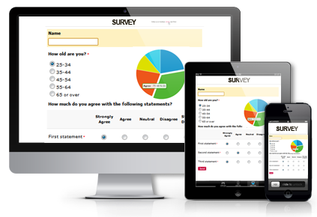
Data Collection
All data were collected using the Survey123 application installed in electronic tablets
Surveyors had experience using the application from previous polio vaccination campaigns in Iraq
Conducted real-time data entry and GPS tracking of survey teams
Allowed CDC and WHO partners to provide remote data quality checks
CDC team gave daily feedback to team supervisors for immediate corrective actions
Notes:
All of our data was collected using the Survey 123 application
Surveyors had experience with Survey 123 from polio vaccination campaigns so this wasn’t their first time using the tablets.
The application allowed us to do real-time data entry and track the location of the survey teams. It also allowed us to provide data quality checks as the survey was being conducted. In cases where we found errors, we provided immediate feedback to those in the field.

Slide 16
RESULTS

Slide 17
Results
1,226 households and 5,007 individuals participated in the survey
The overall household response rate was 99%.
Response rate for individual governorates ranged from 93% - 100%
Notes:
1,226 households and 5,007 individuals participated in the survey
The overall response rate was very good, with 99% of households reporting.

Slide 18
Estimated oral cholera vaccination coverage
 | Overall Estimate
Number of doses | Weighted estimate | 95% CI
2 doses | 87% | (85%, 89%)
1 dose | 7% | (6%, 9%)
* zero doses and incomplete data not shown in table
Notes:
Here we can see the overall estimated vaccination coverage. If you look at the highlighted section you can see that the county-wide 2 dose coverage was 87% and an additional 7% of people received 1 dose of the vaccine. So overall 94% of the people had some exposure to the vaccine.
We also looked to see if there were differences in coverage between men and women or between age groups but found no significant differences in coverage by gender or age group

Slide 19
Coverage estimates in Northern Governorates
Regions and governorates | Number of doses | Weighted estimate | 95% Confidence Interval
Northern Region (pop=154,396) | 2 | 91% | (87%, 94%)
 | 1 | 6% | (4%, 9%)
Dahuk (pop=98,327) | 2 | 90% | (84%, 94%)
 | 1 | 7% | (4%, 12%)
Erbil (pop=34,675) | 2 | 93% | (90%, 96%)
 | 1 | 4% | (2%, 7%)
Sulaymaniya (pop=21,394) | 2 | 93% | (89%, 96%)
 | 1 | 6% | (4%, 10%)
Notes:
We did however find differences in coverage by region. You can see here that the northern region has very high coverage with 91% of people reporting receiving at least 2 doses of the vaccine. An additional 6% of people reported 1-dose coverage meaning 97% of people received at least one dose of the vaccine. Below, you can also see the coverage of the 3 governorates that comprise the northern region.

Slide 20
Coverage estimates in South/Central Governorates
Regions and governorates | Number of doses | Weighted estimate | 95% CI
South/Central Region (pop=78,046) | 2 | 80% | (77%, 82%)
 | 1 | 10% | (8%, 12%)
Anbar (pop=41,070) | 2 | 98% | (93%, 99%)
 | 1 | 2% | (1%, 6%)
Wasit (pop=2,300) | 2 | 91% | (85%, 95%)
 | 1 | 6% | (3%, 12%)
Salah Addin (pop=6,000) | 2 | 81% | (74%, 86%)
 | 1 | 16% | (11%, 22%)
Najaf (pop=14,000) | 2 | 74% | (67%, 81%)
 | 1 | 10% | (6%, 16%)
Baghdad Karkh (pop=6,055) | 2 | 37% | (29%, 44%)
 | 1 | 28% | (20%, 36%)
Kerbala (pop=6,017) | 2 | 30% | (22%, 38%)
 | 1 | 35% | (28%, 42%)
Babil (pop=2,604) | 2 | 21% | (15%, 27%)
 | 1 | 31% | (24%, 39%)
Notes:
In the south/central region the coverage in significantly lower. The 2 dose coverage is 80% and an additional 10% of people received 1 dose coverage meaning 90% of people received at least 1 dose of the vaccine.
You may also notice that there was more variability in coverage between the governorates in the south/central region. Some of these governorates had very high coverage while others had much lower coverage.

Slide 21
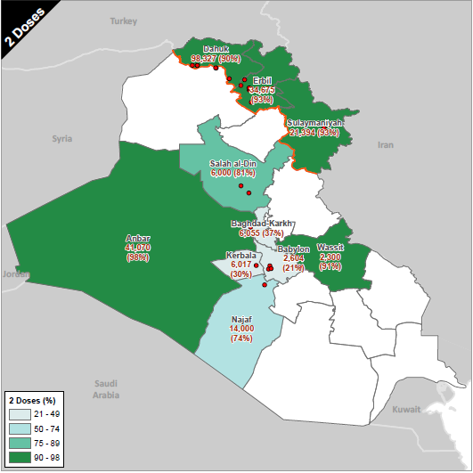
2 dose coverage
Notes:
Here is a visual representation of the overage rates in each governorate. The darker colors represent higher 2 dose coverage. As you can see, the northern governorates have higher rates than the central and southern governorates. Its worth noting that a number of people who were not covered with 2 doses did have at least 1 dose of the vaccine.
Note that the population numbers on this map are the population of the selected refugee camps, IDP camps, and collective centers and are not the overall population of each governorate

Slide 22
Estimates of vaccination coverage by type of camp
Number of Doses | Collective Centers | Refugee Camp | IDP Camp
2 | 64% | 93% | 91%
1 | 17% | 5% | 8%
0 | 19% | 2% | 1%
Notes:
The type of camp was a huge predictor of vaccination status. In collective centers, the coverage was very poor in comparison to in refugee camps and IDP camps. Since collective centers are much less organized, and may have dynamic populations, this is not surprising. The collective centers tend to be located in the central governorates which partially explains the low coverage there.

Slide 23
Estimates of vaccination location
Vaccination location | Weighted estimate | 95% Confidence Interval
House | 90% | (87%, 93%)
Health center | 6% | (4%, 8%)
School | 3% | (2%, 5%)
Market | 1% | (0.2%, 2%)
Other | <1% | (0.1%, 1%)
Notes:
We can also see estimates of vaccination location. 90% of people reported being vaccinated in their homes, 6% reported being vaccinated in health centers, and 3% reporting being vaccinated in schools.

Slide 24
Primary reasons for not receiving oral cholera vaccine (1st Dose)
Reasons for non-vaccination | Weighted estimate | 95% CI
Was absent during the campaign | 35% | (27%, 43%)
Teams did not visit my house | 30% | (23%, 38%)
Vaccines not available | 11% | (7%, 18%)
No faith in vaccine | 4% | (2%, 9%)
Was sick | 3% | (2%, 5%)
Notes:
Here you can see the primary reasons that were cited by people who were not vaccinated.
Of those who did not receive the vaccine, 35% said they were absent during the campaign. 30% said teams did not visit their homes. 11% said that the vaccines were not available.

Slide 25
Side effects reported within 14 days after receiving the 1st or 2nd dose of cholera vaccine
Symptom | Weighted estimate | 95% Confidence Interval
Abdominal pain | 10% | (8%, 14%)
Fever | 5% | (4%, 7%)
Vomiting | 3% | (2%, 5%)
Diarrhea | 2% | (1%, 4%)
Weakness / Fatigue | 1% | (0.3%, 2%)
Notes:
Here we can see side effects after receiving the vaccine. In general side effects were not very common.
10% of people reported abdominal pain. 5% reported fever and 3% reported vomiting.

Slide 26
DISCUSSION

Slide 27
Conclusions
Despite challenges in implementation during a humanitarian crisis, vaccination coverage in Iraq was very high
The post-campaign OCV coverage survey conducted in Iraq reported an overall estimated 87% two-dose coverage
Higher coverage in the Northern governorates compared to the South and Central governorates
Higher coverage in refugee and IDP camps compared to collective centers
Notes:
Despite challenges in implementation during a humanitarian crisis, the coverage in Iraq was very high. The 2 dose coverage was reported at 87%, with 94% of people receiving at least 1 dose of the vaccine.
There was higher coverage in the northern governorates compared to the south and central governorates. There was also higher coverage in refugee and IDP camps compared to collective centers.

Slide 28
Unique Strategies in Iraq
Iraqi MOH adopted a primarily door-to-door strategy
Use of polio eradication assets and activities to support public health emergencies
Extended hours of vaccination into the evening
Captured adult males who worked outside camps during the day
Notes:
There were some unique strategies used in Iraq.
First of all the Iraqi MOH decided to implement a door-to-door strategy to reach people for vaccination. The original strategy of the campaign was to provide the vaccine at fixed post sites around the camps. This was ultimately changed because the Iraqi MOH preferred the home to home visits, since that is what they were comfortable with and had conducted before in previous polio campaigns.
That’s another factor in the success of the campaign. We were able to use the experience of optimizing polio eradication assets, infra-structure, and experience. This was really beneficial to the campaign and shows the legacy of polio eradication efforts in action
Another strategy that was implemented was extending vaccination hours into the evening. This was important because it allowed us to capture adult males who worked outside of the camps during the day and is one reason we did not see differences in vaccination coverage by gender.

Slide 29
Limitations of Campaign
Difficulty of accessing certain areas due to insecurity.
Many non-camp IDPs were not targeted in this campaign
Social mobilization was poor due to the rapid planning and implementation of the campaign
Notes:
There were some limitations of the vaccination campaign.
Some areas of the country were inaccessible due to insecurity.
We also were not able to targets many non-camp IDPs who were not living in an organized environment conducive to vaccination.
In addition, social mobilization was poor due to the rapid planning and implementation of the campaign.

Slide 30
Limitations of Survey
Survey results are only representative of selected camps and collective centers surveyed
Some camps were not surveyed due to security or logistical concerns
Variation in the training of surveyors by supervisors
Surveyors were not able to travel to Erbil for training by CDC and WHO staff
Notes:
There were also some limitations of the survey. Survey results are only representative of camps and collective centers that were surveyed.
Again we couldn’t survey every camp because of security and logistical concerns.
There was also variation in the training of surveyors. Surveyors were not able to travel to Erbil for training by CDC and WHO staff and therefore relied on training by local supervisors, whose quality may have varied by governorate.

Slide 31
Summary
First mass OCV campaign conducted in Iraq
OCV campaigns can be part of a comprehensive response to cholera outbreaks among high-risk populations in conflict settings
Complementary public health intervention of cholera control programs
Notes:
This was the first mass OCV campaign conducted in Iraq. Vaccination is one of the most basic and critical health interventions for protecting vulnerable populations during emergencies. Results from the survey indicated that a high percentage of the target population was vaccinated.
The Iraq experience has also shown that OCV campaigns can be part of a comprehensive response to cholera outbreaks among high-risk populations in conflict settings in addition to provision of safe water, adequate sanitation, and hygiene practices.

Slide 32
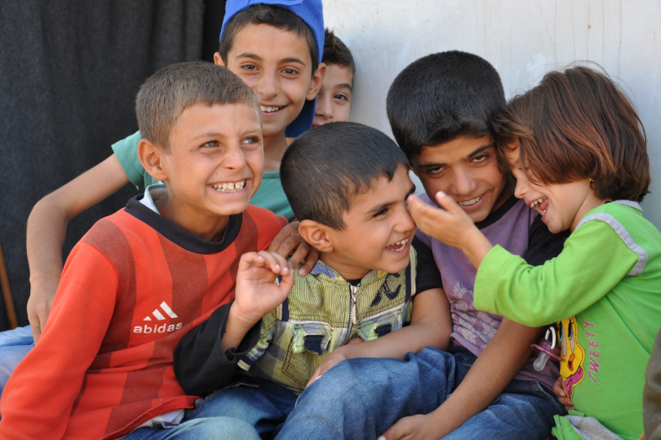
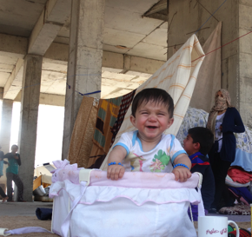
Thank you
For more information please contact Centers for Disease Control and Prevention
1600 Clifton Road NE, Atlanta, GA 30333
Telephone: 1-800-CDC-INFO (232-4636)/TTY: 1-888-232-6348
Visit: www.cdc.gov | Contact CDC at: 1-800-CDC-INFO or www.cdc.gov/info
The findings and conclusions in this report are those of the authors and do not necessarily represent the official position of the Centers for Disease Control and Prevention.
Center for Global Health
Emergency Response and Recovery Branch

Slide 33
Backup Slides

Slide 34
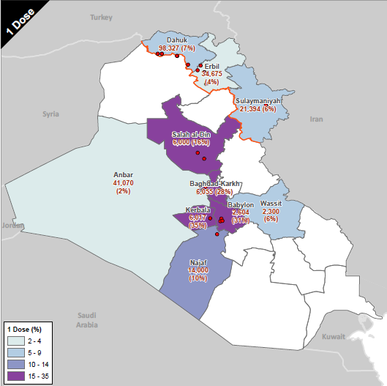
1 dose coverage

Slide 35
Table 1. Household response rate by governorate for oral cholera vaccination coverage survey, Iraq, 2015
Governorate | Responded | Contacted | Governorate response rate
Dahuk | 113 | 122 | 93%
Erbil | 122 | 123 | 99%
Sulaymaniya | 123 | 123 | 100%
Najaf | 127 | 127 | 100%
Baghdad-Karkh | 121 | 122 | 99%
Kerbala | 123 | 123 | 100%
Salah-Addin | 122 | 122 | 100%
Anbar | 120 | 120 | 100%
Wasit | 120 | 120 | 100%
Babil | 135 | 135 | 100%
Grand Total | 1226 | 1237 | 99%
Notes:
Here is a table showing the response rate by governorate. You can see that overall the response rate was really good.
The governorate of Dahuk had the lowest household response rate at 93%.
And one of the reasons we had such a high response rate is that based on our protocol we visited each household up to 3 times. So if there was no response the first time we would revisit multiple times until we c
Based on our protocol, we visited each household up to 3 times if they didn’t initially respond so by the 3rd round we were able to get data from almost everyone.ould get a response.

Slide 36
Table 2. Individual and household characteristics of participants in oral cholera vaccination coverage survey, Iraq, 2015
Individual:
Characteristics | Frequency | Weighted Percent | 95% CI
Sex
Male | 2487 | 49% | (47%, 51%)
Female | 2500 | 51% | (49%, 53%)
Age (years)
1-4 | 650 | 10% | (9%, 11%)
5-14 | 1235 | 21% | (19%, 24%)
≥15 | 3117 | 69% | (66%, 71%)
Household:
Characteristics | Frequency | Weighted Percent | 95% CI
Number of residents per household | 5007 | median: 4 | IQR: 3-5
Improved primary water source ¹ | 2559 | 79% | (74%, 84%)
Improved secondary water source ¹ | 1573 | 55% | (49%, 61%)
Improved sanitation ² | 4043 | 89% | (84%, 92%)
Had soap for handwashing | 4079 | 88% | (84%, 92%)
¹ Improved water sources include: In house piped water, public piped water, protected well, well with pump, protected spring water, and rain water
¹ Improved sanitation sources include: Flush toilets (connected to system, septic pits, or latrines), ventilated and ameliorated pit latrine, and pit latrine with cement slab
Notes:
Here are some of the individual and household level characteristics of the survey participants. Looking at gender you can see that we had an approximately equal distribution of men and women. You can also see the age breakdown, I think the median age of participants was 23 years old.
Looking at the household level characteristic there were about 4 people per household. We also looked at improved vs unimproved water sources and sanitation facilities. Definitions of improved vs unimproved water sources come from WHO/UNICEF guidelines and they are listed at the bottom of the page. In the survey participants were asked about their water source and then their response was classified as either an improved source or an unimproved source.
There were about 4 people per household.

Slide 37
Table 8b. Primary reasons for not receiving oral cholera vaccine (2nd Dose)
Reasons for non-vaccination | Frequency | Weighted estimate | 95% CI
Was absent during second campaign | 148 | 39% | (28%, 51%)
Teams did not visit my house | 419 | 36% | (26%, 46%)
Vaccines not available | 38 | 2% | (1%, 3%)
No faith in vaccine | 1 | <1% | (<0.1%, 1%)
Was sick | 22 | 9% | (4%, 18%)
Bad taste of vaccine | 4 | 1% | (0.3%, 6%)
Decision maker not at home | 2 | 5% | (2%, 18%)
Vaccinator was not there | 1 | <1% | (<0.1%, 2%)
No response | 1 | <1% | (<0.1%, 1%)
Busy / No time | 5 | 1% | (0.3%, 3%)
Didn’t know when or where to go | 3 | <1% | (0.1%, 2%)
Clinic was closed | 6 | 3% | (1%, 13%)
Bad experience / adverse event after first dose | 12 | 2% | (1%, 7%)
Did not know they needed a second dose | 2 | <1% | (<0.1%, 1%)
Other | 6 | 1% | (0.1%, 2%)
Notes:
And here you see the reasons cited for missing the second dose of the vaccine.
And here you can see a very similar table, the only difference is that this time were are looking at reasons for missing the 2nd dose. So the top 2 responses were the same, again people said they weren’t there during the campaign or the teams didn’t visit. Another reason that was cited here was sickness.

Slide 38
Table 10. Information sources about the oral cholera vaccination campaign
Source | Frequency | Weighted estimate | 95% Confidence Interval
Television | 1046 | 19% | (15%, 24%)
Neighbors/Friends | 599 | 13% | (10%, 16%)
Radio | 315 | 12% | (9%, 17%)
MoH Health Staff / Vaccinators | 579 | 7% | (5%, 10%)
Poster/Banner | 521 | 7% | (5%, 9%)
Schools | 88 | 3% | (2%, 6%)
Community Mobilizer | 62 | 3% | (2%, 6%)
SMS | 57 | 3% | (2%, 5%)
Mosque Announcements | 62 | 1% | (0.3%, 3%)
Internet | 40 | <1% | (<0.1%, 0.2%)
Notes:
Here we have a table showing how people heard about the vaccination campaign. People heard from a variety of sources including television, neighbors, friends, and the radio.
This is something to improve upon. Social mobilization for the campaign was low.

Slide 39
Table 11. Information received among households other than cholera during the OCV campaign
Did you receive any other information on cholera during the campaign in Nov-Dec 2015? | Frequency | Weighted Percent | 95% Confidence Interval
Yes | 2410 | 55% | (49%, 61%)
No | 1743 | 33% | (29%, 37%)
What information did you hear?
Wash hands with soap and water | 2023 | 33% | (28%, 39%)
Cook food thoroughly | 930 | 14% | (11%, 18%)
Wash vegetables/fruits | 1413 | 13% | (10%, 16%)
Boil water | 794 | 15% | (12%, 18%)
Clean cooking utensils/vessels | 635 | 6% | (4%, 8%)
Dispose of human waste properly | 519 | 5% | (4%, 7%)
Drink or use water treated with chlorine products | 334 | 4% | (3%, 7%)
Go to health center if I have cholera | 312 | 4% | (3%, 6%)
Take ORS if I have cholera | 163 | 3% | (1%, 6%)
Don’t know/don’t remember | 35 | <1% | (0.1%, 0.4%)
Other, specify | 5 | <1% | (<0.1%, 0.1%)
Notes:
So here we have a table showing information received by households during the campaign. This is additional health messaging that was given while the surveyors were visiting the houses. You can see that only 55% of people said they had received this messaging. So this is definitely something that can be improved on in the future.
Most commonly people were told to wash their hands. Some were also told to cook their food thoroughly, to wash their fruits and vegetables and to boil water. And so again this is something that ideally would be approved upon in the future.

Slide 40
Table 12. Specific primary and secondary water sources reported by households during the OCV campaign
Primary water source | Frequency | Weighted estimate | 95% Confidence Interval
Piped water, in house | 1734 | 71% | (66%, 76%)
Piped water, public | 825 | 14% | (11%, 17%)
Water truck/water vendor | 1185 | 11% | (9%, 14%)
Bottled water | 651 | 4% | (3%, 5%)
River/stream/lake/irrigation canal | 10 | <0.1% | (<0.1%, 0.3%)
Well, unprotected | 10 | <0.1% | (<0.1%, 0.2%)
Spring water, unprotected | 5 | <0.1% | (<0.1%, 0.2%)
Secondary water source | Frequency | Weighted estimate | 95% Confidence Interval
Piped water, in house | 737 | 34% | (29%, 39%)
Water truck/ water vendor | 923 | 26% | (20%, 31%)
Piped water, public | 779 | 15% | (14%, 17%)
Bottled water | 1591 | 12% | (10%, 16%)
Well, protected | 57 | 9% | (7%, 14%)
Well, unprotected | 175 | 2% | (1%, 4%)
Second source not available | 105 | 1% | (0.4%, 1%)
Other | 38 | 1% | (0.3%, 1%)
Spring water, unprotected | 9 | <1% | (<0.1%, 0.2%)

Slide 41
Table 13. Specific sources of sanitation reported among households during the OCV campaign
Sources of sanitation | Frequency | Weighted estimate | 95% Confidence Interval
Pit latrine with cement slab | 1531 | 56% | (50%, 62%)
Flush, connected to system | 941 | 26% | (21%, 31%)
Flush, connected to septic pits | 1226 | 11% | (9%, 13%)
Pit latrine, without cement slab | 151 | 4% | (2%, 6%)
Flush, connected to latrines | 310 | 2% | (1%, 2%)
Bucket toilet | 210 | 1% | (1%, 2%)
Pit latrine, ventilated and ameliorated | 15 | 1% | (0.2%, 2%)
Hanging toilet/Hanging latrine | 35 | <1% | (<0.1%, 0.2%)
Other | 4 | <1% | (<0.1%, 0.2%)

Slide 42
Table 14. Overall estimate of oral cholera vaccination coverage by vaccination card status, Iraq, 2015
Number of doses | 2 Card (n=1498) | 1 card (n=724) | Recall (n=2765) | Total
2 (n=3523) | 47% | 27% | 13% | 87%
1 (n=745) |  | 5% | 3% | 8%
0 (n=739) |  |  | 4% | 4%
 | 47% | 32% | 20% | 99%
*1% don't remember / incomplete
Notes:
Among those who reported receiving two OCV doses, only 47% had both doses recorded on their vaccination cards while 27% had only one dose recorded and 13% had no documentation available.
This finding suggests a need for reminding vaccine recipients to bring back vaccination cards for the second round and also improvement in training of vaccination card recording for survey teams.

Slide 43
Table 15. Did you (or child) spit part of the first or second dose of the vaccine due to bad taste?
Response | Frequency | Weighted estimate | 95% Confidence Interval
Yes | 509 | 25% | (22%, 28%)
No | 3694 | 72% | (69%, 75%)
Don't know | 41 | 1% | (0.4%, 1%)
Missing | 30 | 2% | (1%, 4%)

Slide 44
Table 16. Availability of soap and hygiene practices reported among households during the OCV campaign
Soap for handwashing | Frequency | Weighted estimate | 95% Confidence Interval
Yes | 4079 | 88% | (84%, 92%)
No | 338 | 4% | (2%, 7%)
If yes, when do you wash your hands with soap?
After using the toilet | 3798 | 86% | (81%, 90%)
Before eating | 2838 | 52% | (47%, 58%)
After eating | 2659 | 48% | (43%, 52%)
Before cooking | 1359 | 34% | (29%, 40%)
After washing/cleaning tables | 1096 | 20% | (16%, 23%)
After cleaning baby diapers/baby stools | 1018 | 13% | (10%, 16%)
After cleaning the home | 749 | 9% | (7%, 13%)
Other | 8 | 1% | (0.2%, 4%)

Slide 45
Table 17. Improved vs unimproved primary and secondary water sources reported among households during the OCV campaign
Source | Frequency | Weighted estimate | 95% Confidence Interval
Primary Water Source
Improved ¹ | 2559 | 79% | (74%, 84%)
Unimproved ² | 1861 | 14% | (12%, 17%)
Missing | 48 | 7% | (4%, 11%)
Secondary Water Source
Improved ¹ | 1573 | 55% | (49%, 61%)
Unimproved ² | 2744 | 38% | (32%, 44%)
Second source not available | 105 | 1% | (0.4%, 1%)
Missing | 46 | 7% | (4%, 11%)
¹ Improved water sources include: In house piped water, public piped water, protected well, well with pump, protected spring water, and rain water
² Unimproved water sources include: unprotected well, unprotected spring water, river/stream/lake/irrigation canal, bottled water, and water truck/water vendor

Slide 46
Table 18. Improved vs. unimproved sources of sanitation reported among households during the OCV campaign
Sources of sanitation | Frequency | Weighted estimate | 95% Confidence Interval
Improved ¹ | 4023 | 89% | (84%, 92%)
Unimproved ² | 400 | 5% | (3%, 7%)
Missing | 45 | 7% | (4%, 11%)
¹ Improved sanitation sources include: Flush toilets (connected to system, septic pits, or latrines), ventilated and ameliorated pit latrine, and pit latrine with cement slab
² Unimproved sanitation sources include: Pit latrine without cement slab, bucket toilet, hanging toilet/hanging latrine, canal or open defecation/bush/field

Slide 47
Table 19. Type of Camp
Governorate | Sites | (Refugee or IDP or CC)
Dahuk | Bajet Kandala | IDP
 | Esyan | IDP
 | Bardarash | IDP
 | Khanke | IDP
 | Domiz Camp 1 | Refugee
 | Domiz Camp 2 | Refugee
Erbil | Harshm | IDP
 | Darashakran Camp | Refugee
 | Kawergosk Camp | Refugee
 | Qushtapa Camp | Refugee
 | Baharka | IDP
 | Basirma Camp | Refugee
Sulaymaniya | Arbat IDP | IDP
 | Arbat 2 (Ashti) | IDP
 | Arbat Camp | Refugee
Najaf | Ba Husein Road | CC
Baghdad Kardh | Alahal Camp | Refugee
 | Takiya kasnazaniya | CC
Kerbala | Displaced population CC | CC
Salah Addin | Alhwaish | CC
 | Alishagee | CC
Anbar | Amiria carvans camp | Refugee
 | Alamiria tourist camp | Refugee
Wasit | Numania Shoamali Street CC | CC
Babil | Collective center – population 856 | CC
 | Collective center – population 738 | CC
 | Collective center – population 1010 | CC

Slide 48
Survey Questions
Each interview consisted of individual and household level questions.
Individual level questions included:
demographic information
vaccination status
reasons for non-vaccination
adverse events following immunization (AEFI).
Household level questions were related to campaign awareness as well as water, sanitation, and hygiene (WASH) interventions.
Improved/unimproved primary water source
Improved/unimproved secondary water source
Improved/unimproved sanitation
Number of people who shared a toilet
Soap for handwashing
Notes:
For household level questions we looked at WASH indicators. In any cholera intervention of course it is very important to address the WASH component as well. So collected data on water sources and sanitation related conditions within the camp..

Slide 49
Sample Size Calculations
Assumptions for sample size calculation
2-dose coverage of 75%
Intraclass correlation of 0.2
Average household size of 6
Non-response rate of 5%
Design effect of 2
Wanted to achieve precise estimates for:
Each individual governorate
1-4 year old age group in the northern and south/central regions
We decided to sample 120 households per governorate
4.7% precision for each governorate
8.0% precision in 1-4 age group in each region
Notes:
Before starting the study we conducted some sample size calculations
And we came up with the assumptions
And so some of the goals we had in mind when calculating the necessary sample size were that we wanted to be able to have precise estimates for each individual governorate and we also wanted to have a good estimate for the 1-4 age group in each region.
And so based on these goals we decided that we should sample 120 household in each governorate which would give us a precision of 4.7% for each individual governorate and would also give us that 8% precision we wanted for the 1-4 year age group

Slide 50
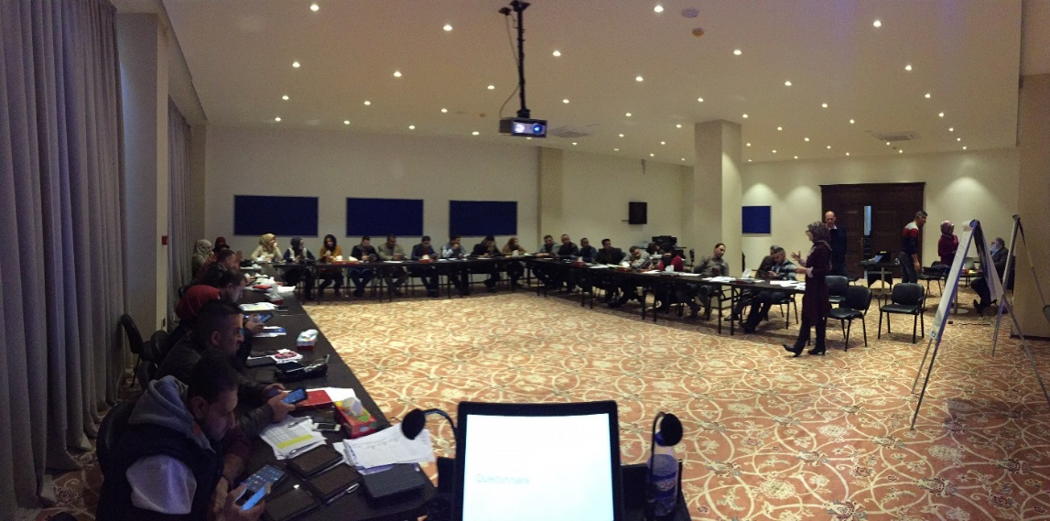
Study Design (cont.)
Some governorates and camps could not be reached due to security concerns
Only the 2 largest camps in the governorates of Anbar and Baghdad-Karkh were selected
Notes:
So continuing on with some of the more practical aspects of the study design
we decided to exclude camps that had a population of less than 500 people, because the sample was proportionally allocated, we would have spent many hours just to sample a few people
We didn’t go to call camps in Angbar and Baghdad-Karkh because of safety and logistical concerns
So our results aren’t necessarily representative of these places

Slide 51


Sampling
1) The sampling interval was calculated based on the estimated number of households in a camp and the desired sample size
A random start was selected
Between the 1st household at the corner of the camp and the $n^{th}$ household (based on sampling interval)
3) Households were systematically sampled using the sampling interval
4) In camps where the population size was larger than estimated, the survey team continued to sample households using the pre-prescribed sampling interval
Sampling interval
Random start
Notes:
In order to carry out our sampling in each individual camp, the first thing we did was create a predetermined sampling interval, which was calculated by dividing the number of household in a camp by the number of households we planned on sampling according to our study design.
Once we had calculated our sampling interval, the next thing we did was chose a random start. That starting place was selected by randomly choosing a household between the 1st household and the nth household starting from the corner of a camp. So for example if our sampling interval was 3, we randomly chose one of the first 3 listed households.
Next, we systematically worked through the camp and selected every nth household based on the sampling interval. So again in this example we sampled every third household.
In some cases, the we may have underestimated the number of household in a camp. I that case, we would have reached our desired sample size before reaching the end of the camp. And so when that happened we continued with our pre-determined sampling interval to reduce potential bias.

Slide 52
Survey Weighting
Used the complex survey procedures in SAS for analysis
Data were weighted based on:
1) Probability of selection
2) Household non-response
3) Individual non-response
Ensured each camp’s weights summed to population of the camp
Notes:
Survey data was then weighted before we used the complex survey procedures in SAS
Data were weighted to account for differences in probability of selection based on the sampling rate within a camp and on non-response
And we ensured that each camp’s weight summed to the population of the camp
Weights are calibrated so that sum of weights in each camp = population of camp
So then each person’s final weight corresponds to the number of people who they represent

Slide 53
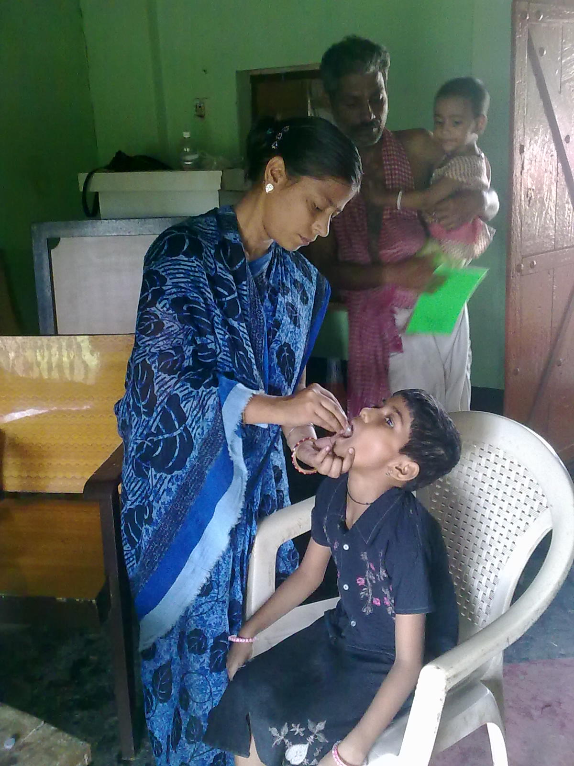
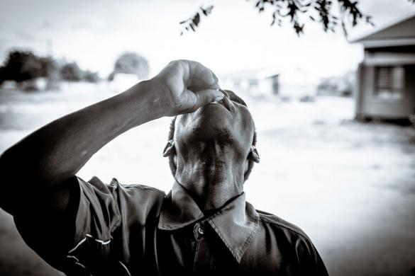
Vaccine Instructions
Dosage and Administration
ShancholTM cholera vaccine must be administered orally; it should never be given parentally.
It is packed in a glass bottle of 1.5ml.
The vaccine is given in two doses spaced between 2 to 6 weeks
No re-dosing for individuals who spit out

Slide 54
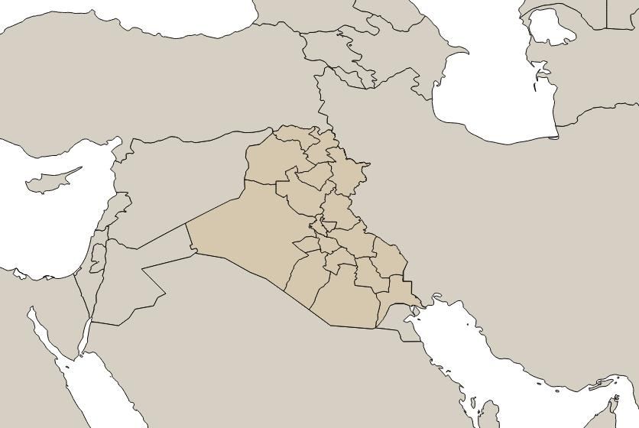
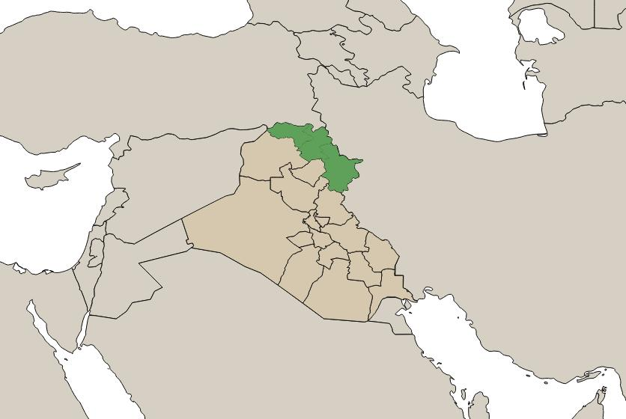
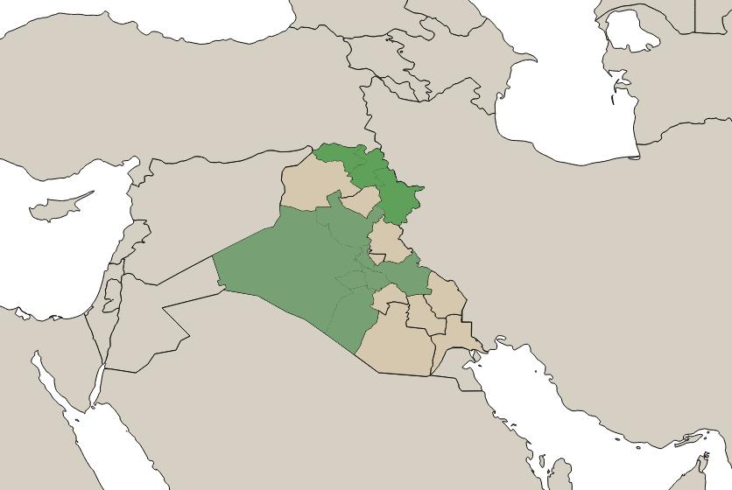


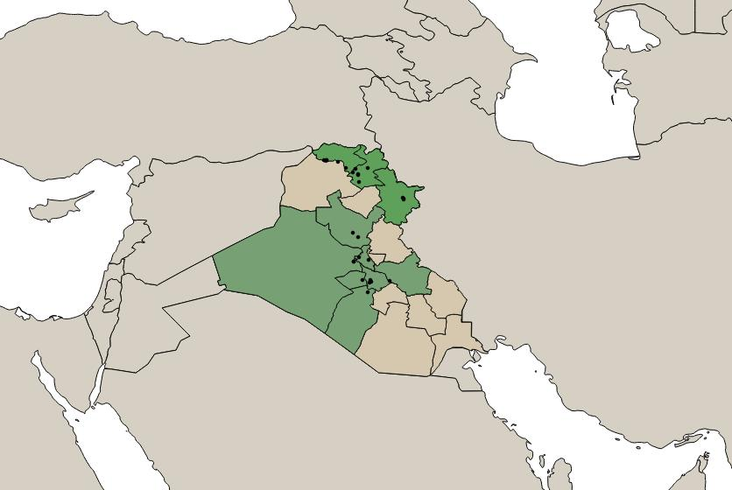

Slide 56
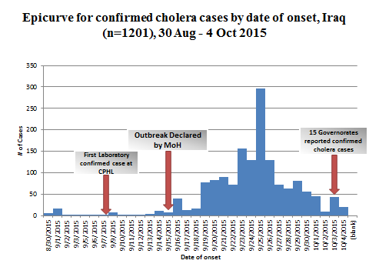
Confirmed cholera cases by date of onset, Iraq, August 30 – October 4, 2015

Slide 57
Notes:
Officially established IDP camps that are under-crowded, areas in the central region that are reporting already very high attack rates, and big urban centres because of the lack of operational feasibility of organizing vaccination campaigns have not been included in the campaign.

